Slide 3
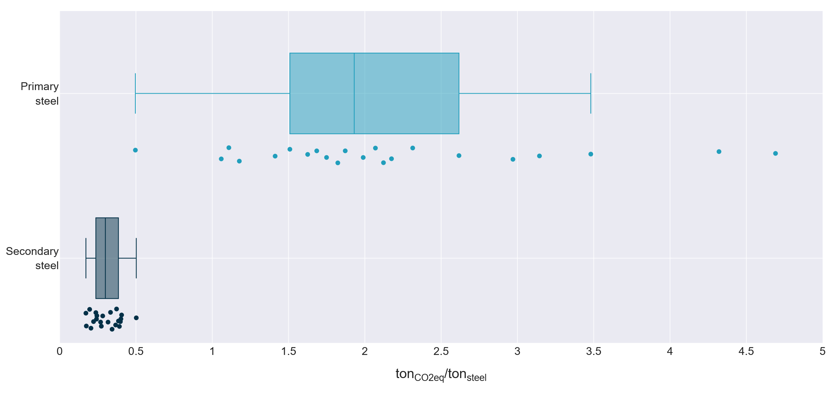
IN
EU
KR
US
JP
RU
CN

Slide 4
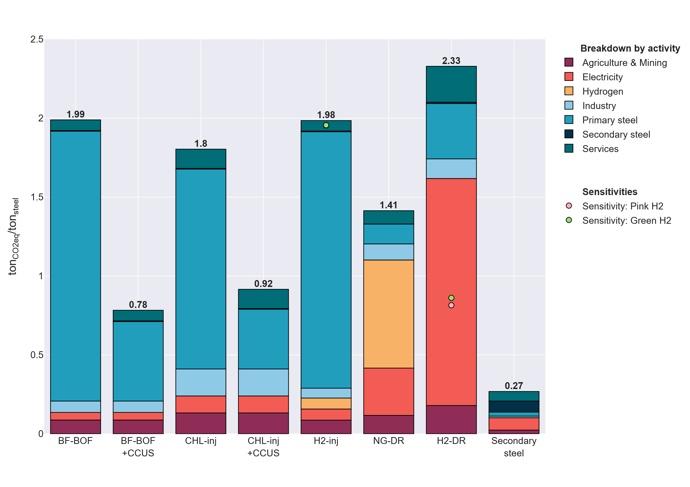

Slide 5
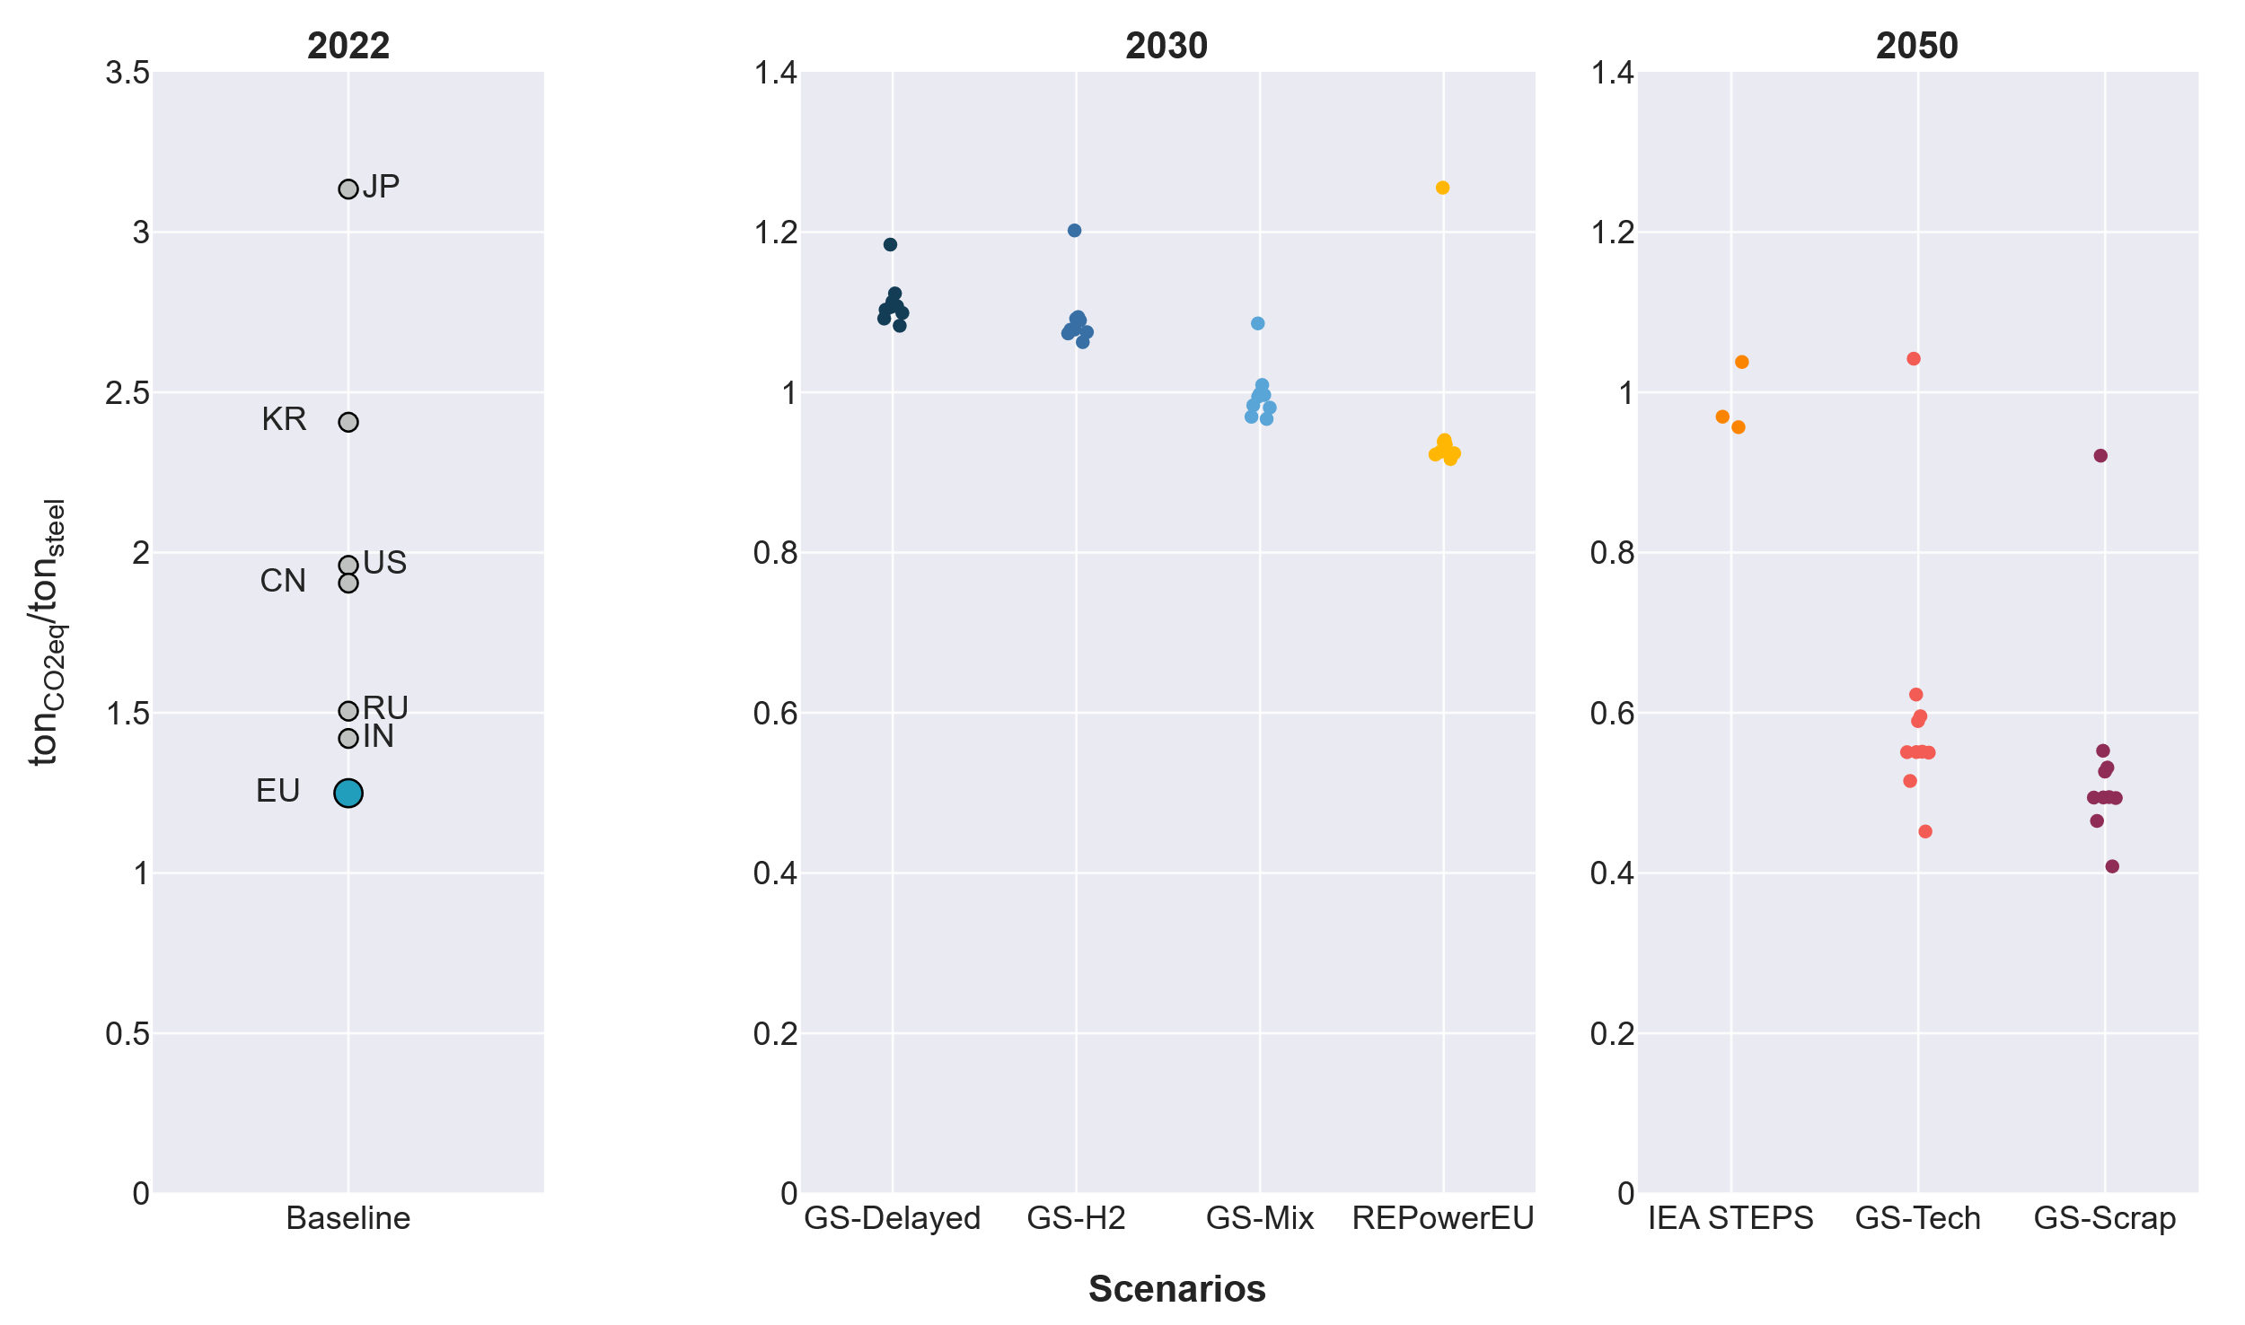
EE 2022
CCUS min
CCUS
max
Focus on EU by scenario
EE Clean

Slide 6
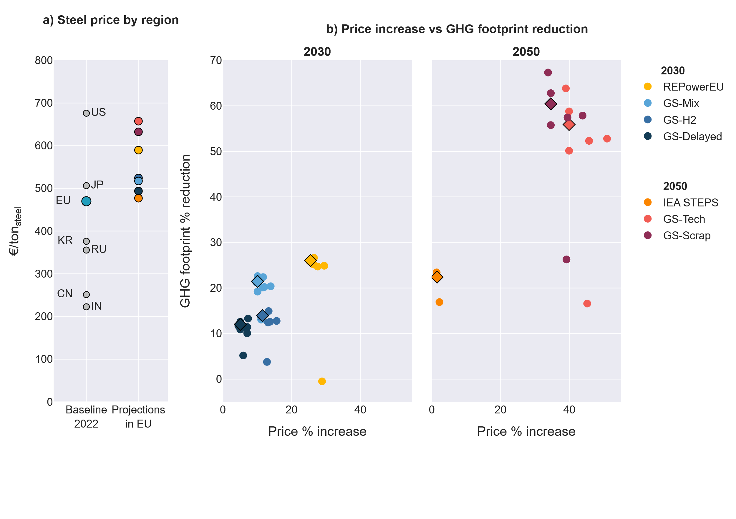
a) Steel price
by region
b) Steel price increase vs GHG footprint reduction in EU
Average case
by scenario
EE 2022

